Slide 1
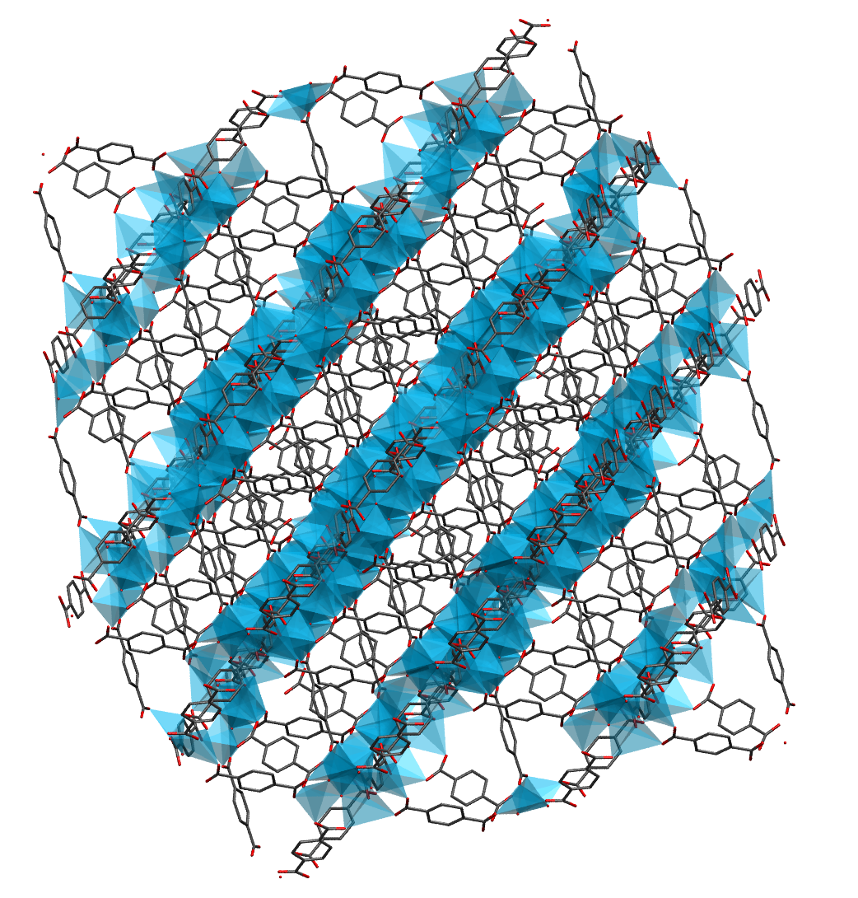
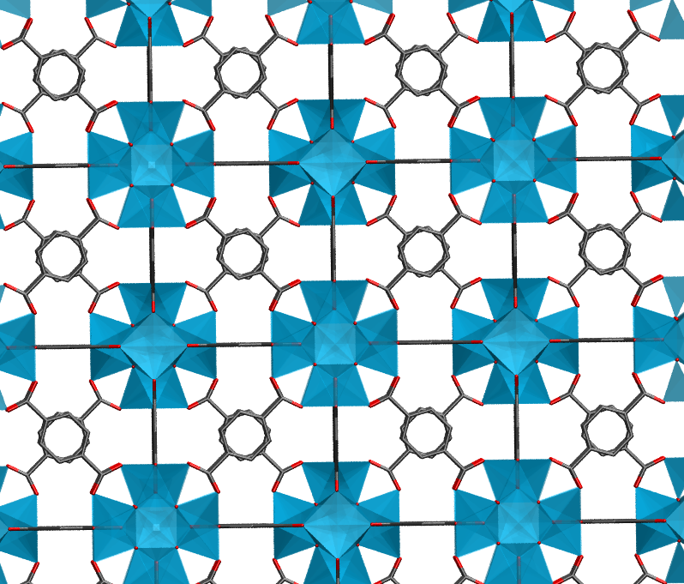
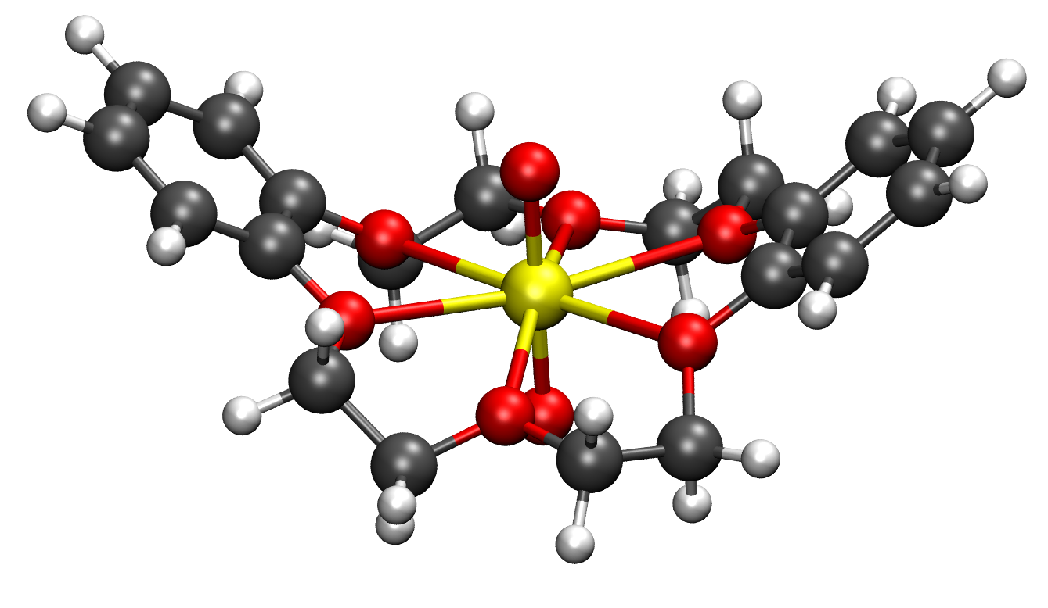
(UO₂)²⁺ and
chelating ligand
NanoMOF
Pristine MOF

Slide 2
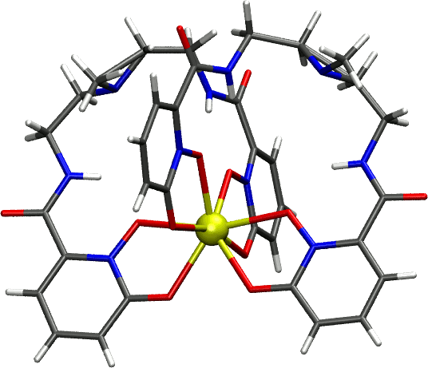

Slide 3
U-X
U-X-U
= N, P, and O donating ligands
X = arenes, N, O
U-X-U

Slide 4
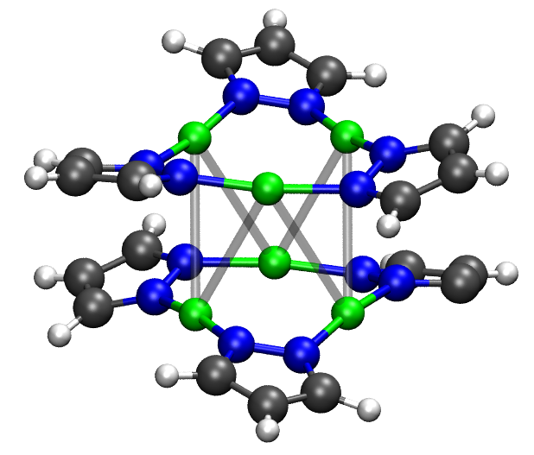
Spin-Crossover Complexes
Single Molecule Magnets
Organoactinide Systems
Gd MRI Contrast Agents
Ln photosensors
Metal Clusters
Multi-metallic SMMs
Multi-metallic catalysts
Model Enzyme active sites

Slide 5

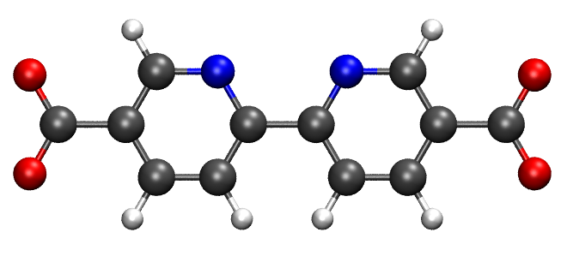
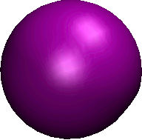
Quantum Chemical System
Calculate the interaction energy
Fit to a Force Field
Code to stream-line process
Run simulations for
pristine and NanoMOFs
Calculate Properties
Return to fitting
if not converged
✔
✗

Slide 6
Hartree Fock
CASSCF
Empty
(Virtual)
Active
Occupied
(Inactive)

